Slide 1
Web-Based Data Migration Management Tool for Multi-Cloud Services
CPSC 454 Fall 2019
Duy Do: duy.ado@csu.fullerton.edu, undergraduate, CS
Jason Lieu: jasonlieu@csu.fullerton.edu, undergraduate, CS
Maxfield Wilhoite: maxw@csu.fullerton.edu, undergraduate, CS
Video Presentation:
MP4-format: https://drive.google.com/drive/folders/1aZPz1VTcdOSQO73m0sKFsQZ0PNuNZR9H?usp=sharing
MOV-format:https://drive.google.com/drive/folders/1nBWL4rFfxyhftK2AzB_cUsENXaDbMisu?usp=sharing

Slide 2
Objective of project
Centralized Data Migration/Management Tool via Web Interface
Manage Data between different cloud/cloud provider - Amazon, Google (other in future).
Migration with Security in mind.

Slide 3
Old Setup
Cloud: Amazon’s EC2, Google Cloud
Framework:Flask_API, CORS, PugSQL, Paramiko’s SCP
Language: Python3, JavaScript, HTML, CSS
Database: SQLite
OS: Linux

Slide 4
Current Setup
Cloud: Amazon’s EC2, Google Cloud, AWS Lambda, AWS S3, AWS API Gateway
Framework:Flask_API, CORS, PyMSQL, Paramiko’s SCP, Python requests
Language: Python3, JavaScript, HTML, CSS
Database: MySQL
OS: Linux

Slide 5
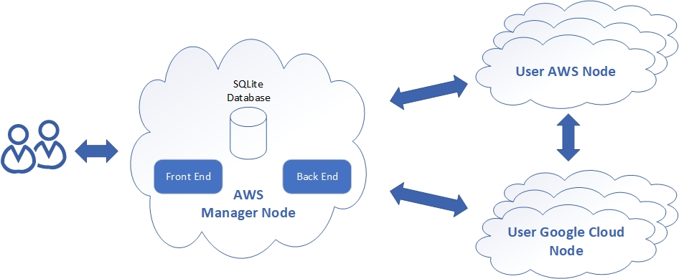
Old View of our system

Slide 6
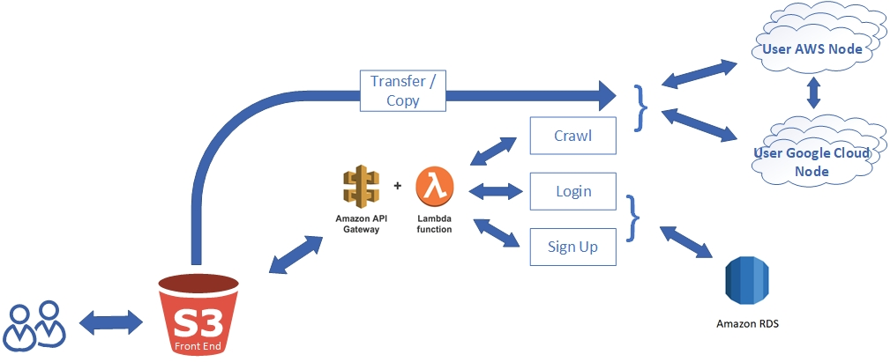
Current View of our system

Slide 7
WHY ? YOU MAY ASK?

Slide 8
we saw how cool lambda is from you guys

Slide 9


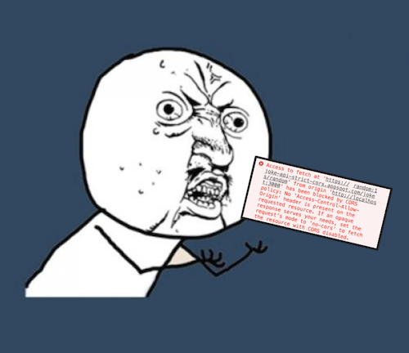

but Also….

Slide 10
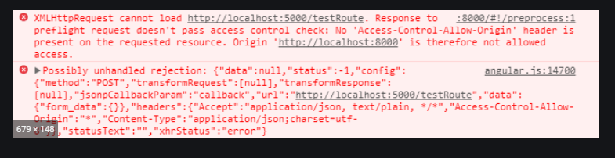
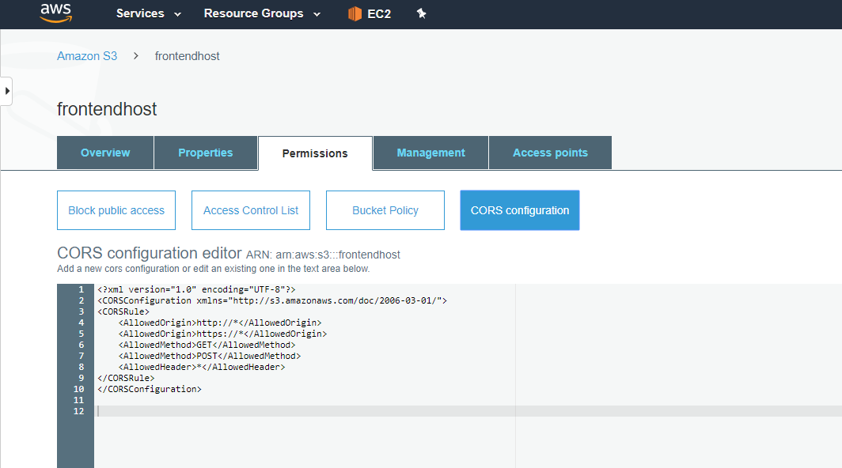
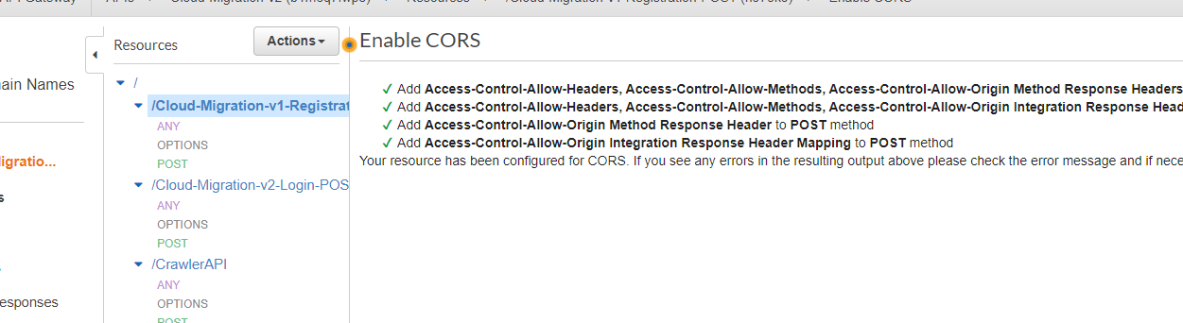
Problems Encountered
CORS Policy (again)
Access-Control-Allow-Origin: *
Access-Control-Allow-Origin: http://www.example.com

Slide 11
so we disabled CORS

Slide 12
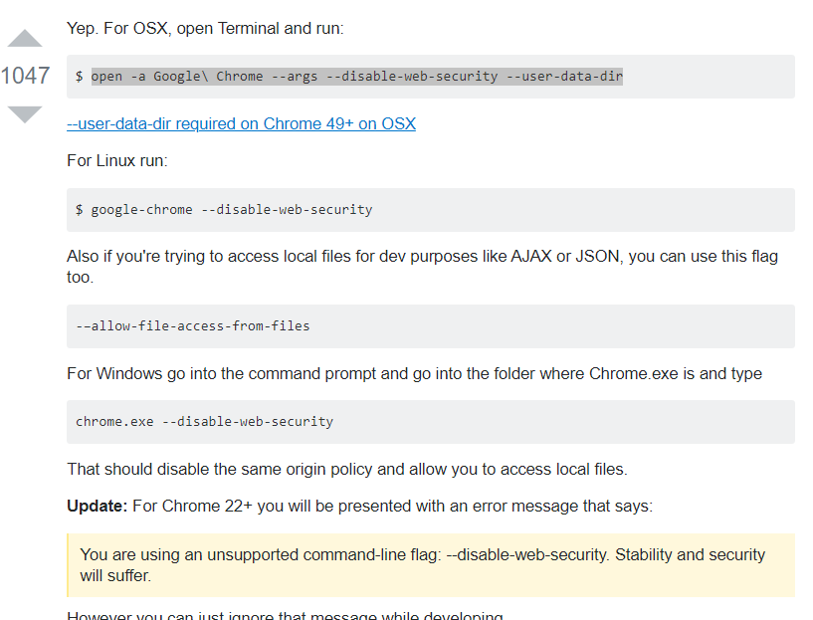
DID What Sane People would do - pick your poison

Slide 13
DEMO

Slide 14
Accomplished Since midterm
Implement deleting of files across user clouds ✔️
Implement moving of files across user clouds ✔️
Currently we are manually setting up each user node, would like to fully automate interfacing with our manager node - ⚠️, just need to clone repo to user clouds
Modifications and improvements to front end interfacing ✔️
User defined nodes, no longer hardcoded ✔️
Move our manager API to Lambda and Gateway API for load balancing ✔️
Move the Database to S3 Bucket ✔️
Move frontend to S3 Bucket ✔️
Key Management ~kinda? 😢
NOTE***: All at the cost of CORS!

Slide 15
Sources Used For Research
[1] Mell, P., Grance, T, “The NIST Definition of Cloud Computing, ” National Institute of Standards and Technology. 2011.
[2] M. Almorsy, J.C. Grundy, I. Müller, “An Analysis of the Cloud Computing Security Problem”, 2010. ArXiv, abs/1609.01107.
[3] A. James, “SSH and SCP: Howto, tips & tricks”. LinuxAcademy, 2012.
[4] Z. Li, X. Li, T. Liu, S. Yang and J. Xie, "A preliminary data transfer model for private remote sensing cloud," 2016 IEEE International Conference on Big Data Analysis (ICBDA), Hangzhou, 2016, pp. 1-5. doi: 10.1109/ICBDA.2016.7509816
[5] T. Huang, K. Chu and Y. Rao, "Smart Intermediate Data Transfer for MapReduce on Cloud Computing," 2013 International Conference on Cloud Computing and Big Data, Fuzhou, 2013, pp. 9-14. doi: 10.1109/CLOUDCOM-ASIA.2013.97
[6] Y. Yu, J. Ni, W. Wu and Y. Wang, "Provable Data Possession Supporting Secure Data Transfer for Cloud Storage," 2015 10th International Conference on Broadband and Wireless Computing, Communication and Applications (BWCCA), Krakow, 2015, pp. 38-42. doi: 10.1109/BWCCA.2015.44
[7] R. Tudoran, A. Costan, R. Wang, L. Bougé and G. Antoniu, "Bridging Data in the Clouds: An Environment-Aware System for Geographically Distributed Data Transfers," 2014 14th IEEE/ACM International Symposium on Cluster, Cloud and Grid Computing, Chicago, IL, 2014, pp. 92-101. doi: 10.1109/CCGrid.2014.86
[8] C. Jayashri, P. Abitha, S. Subburaj, S. Y. Devi, Suthir S and Janakiraman S, "Big data transfers through dynamic and load balanced flow on cloud networks," 2017 Third International Conference on Advances in Electrical, Electronics, Information, Communication and Bio-Informatics (AEEICB), Chennai, 2017, pp. 342-346. doi: 10.1109/AEEICB.2017.7972328
[9] V. Dubey and P. Agrawal, "Cloud computing and data management," 2016 Symposium on Colossal Data Analysis and Networking (CDAN), Indore, 2016, pp. 1-6. doi: 10.1109/CDAN.2016.7570892
[10] C. B. M. Lek, O. B. Yaik and L. S. Yue, "Cloud-to-cloud parallel data transfer via spawning intermediate nodes," TENCON 2017 - 2017 IEEE Region 10 Conference, Penang, 2017, pp. 657-661. doi: 10.1109/TENCON.2017.8227943
[11] Cloud Fare. (2019). What Happens in a TLS Handshake? | SSL Handshake. [online] Available at: https://www.cloudflare.com/learning/ssl/what-happens-in-a-tls-handshake/

Slide 16
NEw Sources
[12] Medium. (2019). 3 Ways to Fix the CORS Error — and How Access-Control-Allow-Origin works. [online] Available at: https://medium.com/@dtkatz/3-ways-to-fix-the-cors-error-and-how-access-control-allow-origin-works-d97d55946d9.
[13] Medium. (2019). API-Gateway S3 Proxy. [online] Available at: https://medium.com/@JCDubs/api-gateway-s3-proxy-a72e398b4d03.
[14] PyLenin, f. (2019). AWS Lambda Deployment Package in Python. [online] Youtube.com. Available at: https://www.youtube.com/watch?v=rDbxCeTzw_k [Accessed 5 Dec. 2019].
[15] Stack Overflow. (2019). Disable same origin policy in Chrome. [online] Available at: https://stackoverflow.com/questions/3102819/disable-same-origin-policy-in-chrome.
[16] www.boxuk.com. (2019). Enabling cross-domain access in CloudFront | Insight | Box UK. [online] Available at: https://www.boxuk.com/insight/enabling-cross-domain-access-in-cloudfront/.
[17] Pymysql.readthedocs.io. (2019). Examples — PyMySQL 0.7.2 documentation. [online] Available at: https://pymysql.readthedocs.io/en/latest/user/examples.html.
[18] Docs.aws.amazon.com. (2019). Tutorial: Configuring a Lambda Function to Access Amazon RDS in an Amazon VPC - AWS Lambda. [online] Available at: https://docs.aws.amazon.com/lambda/latest/dg/services-rds-tutorial.html.

